Slide 1








Design Laboratory - II (ME306)
WAVE ENERGY CONVERTER CONTROL SYSTEM WITH VIBRATION AND MECHANICAL CONTROL
Supervised by:
Jitendra Prasad Srikant Sekhar Padhee
Presented By -
Ankur Singh (2022MEB1298)
Arnav Maitreya (2022MEB1299)
Akshat Srivastava (2022MEB1294)
Ainala Kannaiah (2022MEB1292)
Akshat Pathak (2022MEB1293)

Slide 2
OBJECTIVE
To simulate and analyze a point-absorber Wave Energy Converter (WEC) for efficient wave energy harvesting.
Implement a vibration-based control strategy using a PID controller to stabilize and enhance energy conversion.
Employ machine learning to predict optimal PID values for maximum power generation.
Validate system performance using Simulink and Simscape simulations.

Slide 3
PROJECT OVERVIEW
The project focuses on energy extraction from sinusoidal ocean waves using a mechanical oscillator.
A PID controller is tuned to control the damping force, influencing the WEC’s displacement and velocity.
ML is used to learn the relationship between PID parameters and resulting power output, enabling optimization.
Data for ML training is obtained through systematic PID sweeps in simulation.

Slide 4
SYSTEM MODEL
WEC modeled as a mass-spring-damper system influenced by wave-induced sinusoidal forces.
Control signal (from PID) adjusts damping characteristics dynamically.
The system outputs include displacement, velocity, and instantaneous power.
Power is computed as the product of force and velocity over time.

Slide 5
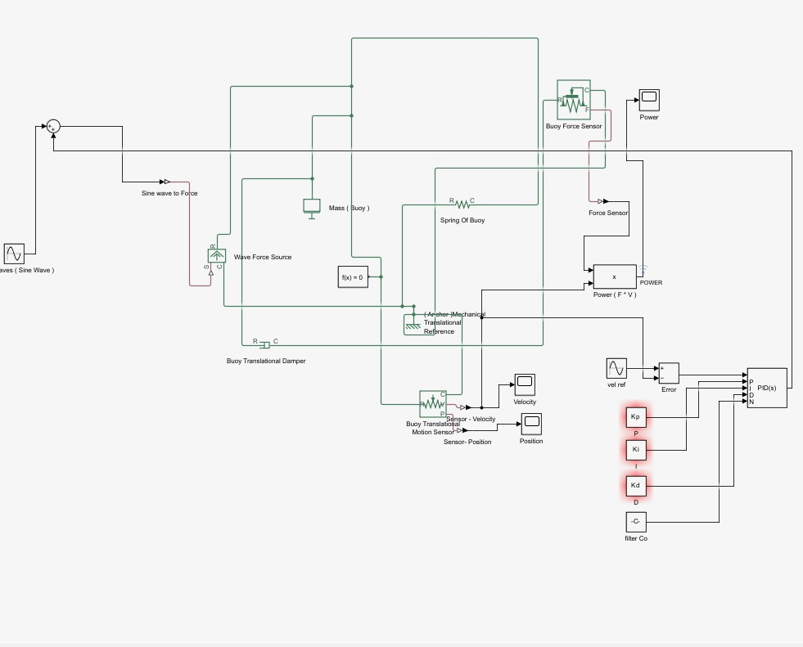

Slide 6
SIMULATION ARCHITECTURE
Equation of Motion: mẍ + cẋ + kx = F(t),
where F(t) = A sin(ωt)
PID input: Error = desired − actual velocity
PID output used to control damping coefficient in real-time
Simulink block models created for: wave force input, dynamic system, PID loop, and power calculator

Slide 7
SIMULATION WORKFLOW
Step 1: Assign physical parameters (mass, spring constant, damping)
Step 2: Implement wave input as a sinusoidal force function
Step 3: Use PID to dynamically adjust the damping
Step 4: Sweep 250 combinations of (Kp, Ki, Kd)
Step 5: Record power output for each set → dataset for ML model

Slide 8
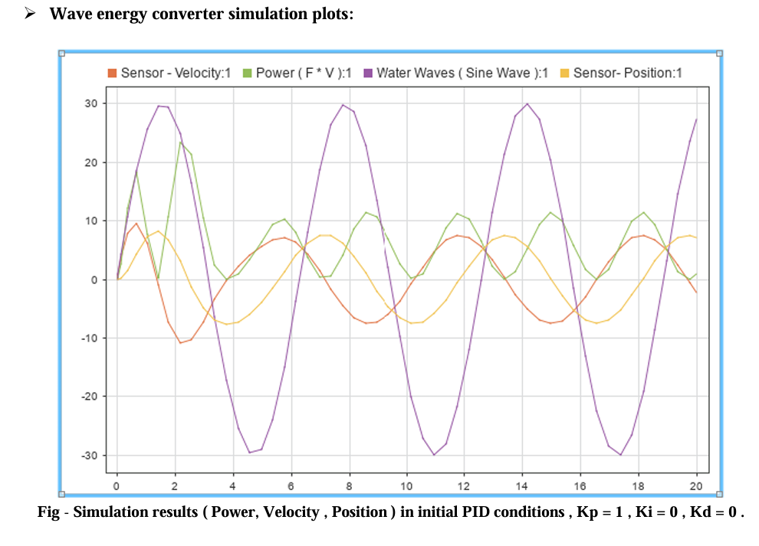

Slide 9
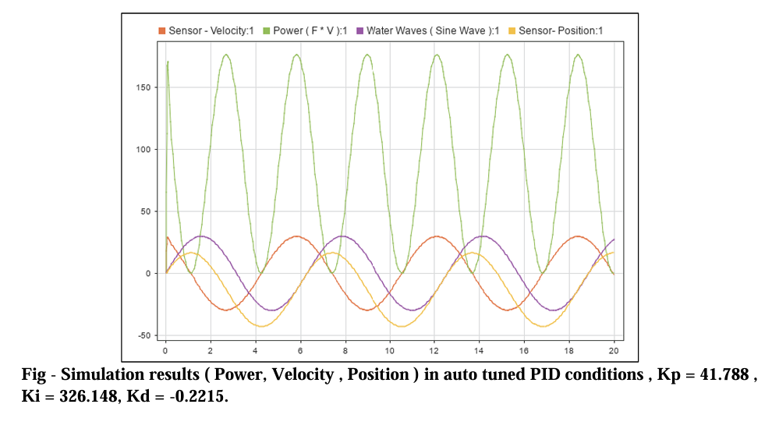

Slide 10
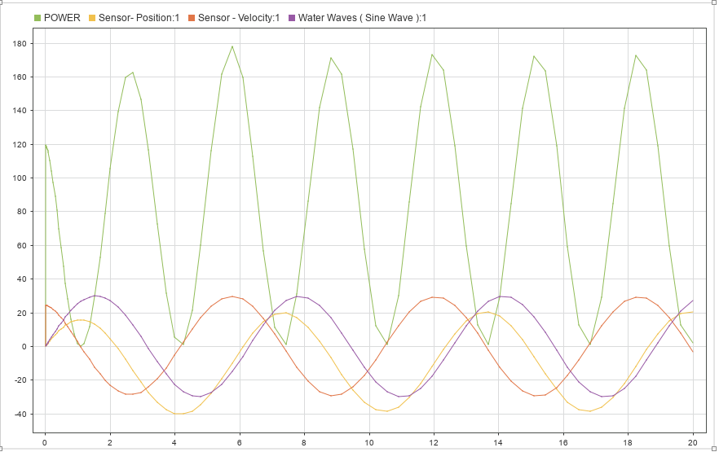
Fig Simulation results ( Power, Velocity , Position ) in ML tuned PID conditions , Kp =28 , Ki = 0 , Kd = 12 .

Slide 11
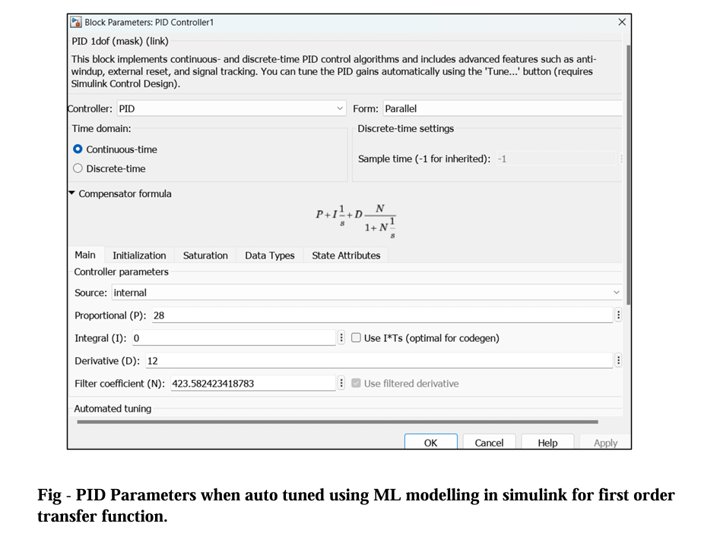

Slide 12
MACHINE LEARNING MODEL
Supervised learning approach using a feedforward neural network (FNN)
Inputs: Kp, Ki, Kd values
Output: Corresponding power output predicted
Architecture: Dense layers with ReLU activations, MSE loss, and Adam optimizer
Trained using the dataset generated from simulations

Slide 13
TRAINING & OPTIMIZATION
250 PID samples split into training and validation sets
Early stopping used to prevent overfitting
Once trained, model is used to evaluate 500,000 random PID sets
PID combination with maximum predicted power selected as optimal

Slide 14
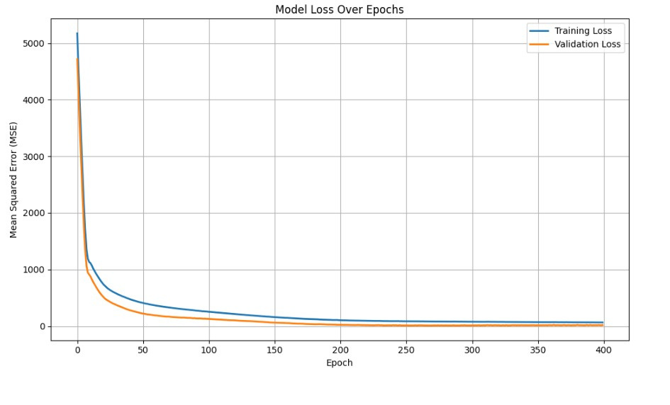
LOSS CURVE

Slide 15
OPTIMIZATION RESULTS
Optimized PID values led to a predicted power output 12.5% higher than original tuned PID
Simulation confirmed improved displacement tracking and increased velocity
ML-based optimization significantly reduced manual trial-and-error tuning

Slide 16
CONCLUSION
Successfully integrated control system simulation with machine learning-based optimization
Demonstrated a practical and scalable approach for improving WEC performance
Framework is extendable to other renewable energy systems with dynamic parameters
Future work: include wave variability, environmental damping, and real-time PID tuning

